Slide 1

Problem
Smart wear is too small to view detail information
Not everyone has smart wear.
Price of android wear is not cheap.

Slide 2
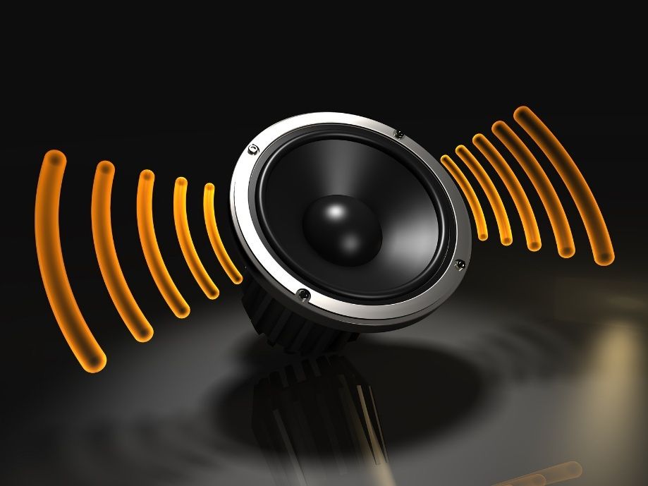
Solution
Provide notify by sound function.

Slide 3
Architecture
List notify string

Slide 4
Architecture
List notify string
Select Download button

Slide 5
Architecture
List notify string
Select Download button
FPT Service

Slide 6
Architecture
List notify string
Select Download button
FPT Service
Return sound file to mobile

Slide 7
Architecture
List notify string
Select Download button
FPT Service
Save to storage
Return sound file to mobile

Slide 8
DEMO
Download audio files to mobile device
Start tracking and notify
At each turn will have sound notify

